Slide 1
"Wellness at Work: Insights from our study on Lifestyle, Mental Health Diagnosis, and Effective Treatments"
Carlota Gordillo | Celia Manzano | Ana Pineda | Laura Sánchez

Slide 2

Project overview
We aim to implement a system to prevent mental health issues among our workers.
Focus: Analyze sleep, stress, and physical activity data, plus effective treatments against mental health diagnosis.
Goal: Identify risks, improve well-being, and reduce absenteeism and low productivity.
Outcome: Position ourselves as leaders in workplace well-being, benefiting employees and clients.

Slide 3
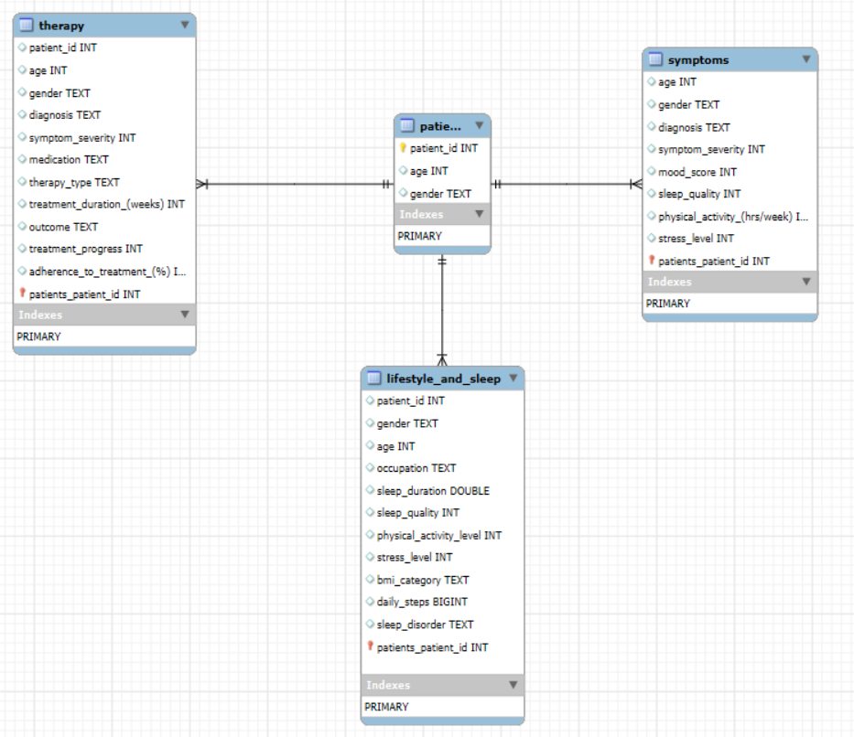
Entity relational model

Slide 4
01
Lifestyle insights
Understanding how different lifestyle factors
affects to the well-being of our workers.

Slide 5
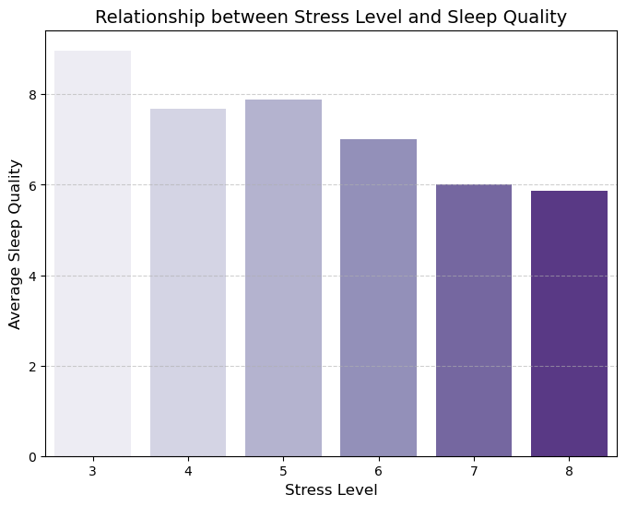
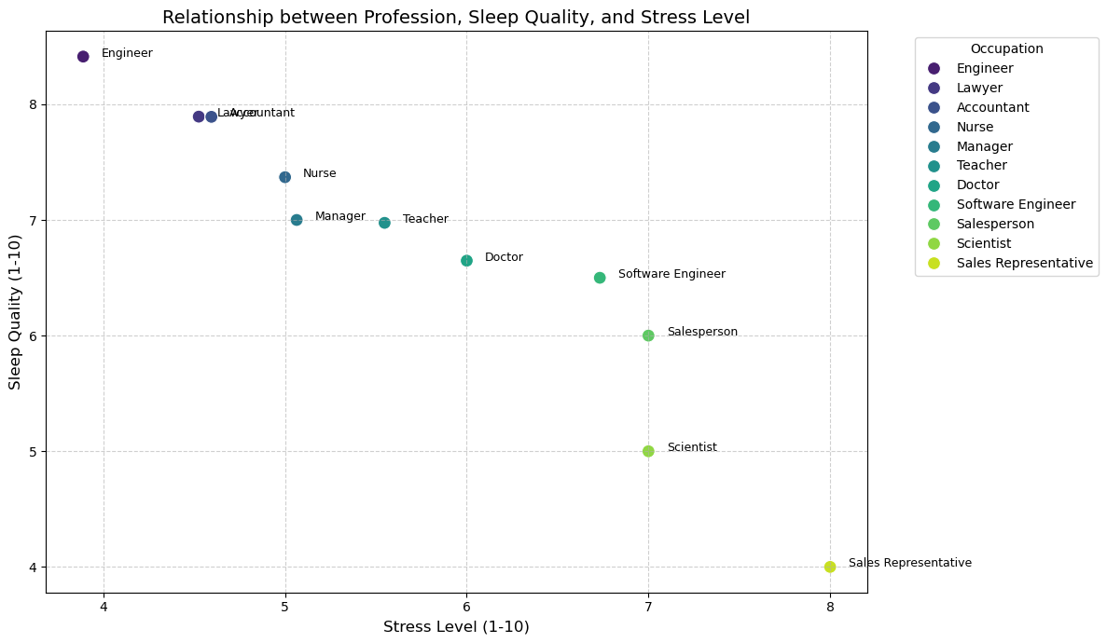
Sleep and Stress
high sleep quality with low stress levels
poor sleep quality despite varied stress levels.
Higher stress levels lead to lower sleep quality, highlighting the negative impact of stress on rest.
Different occupations uniquely balance stress and sleep quality, emphasizing the need for tailored well-being strategies.

Slide 6
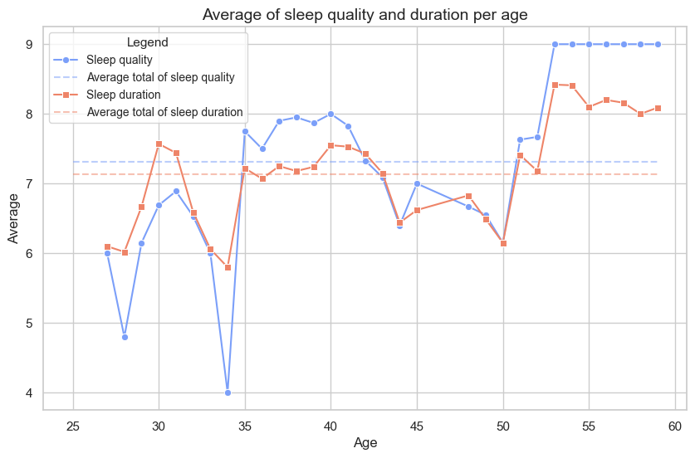
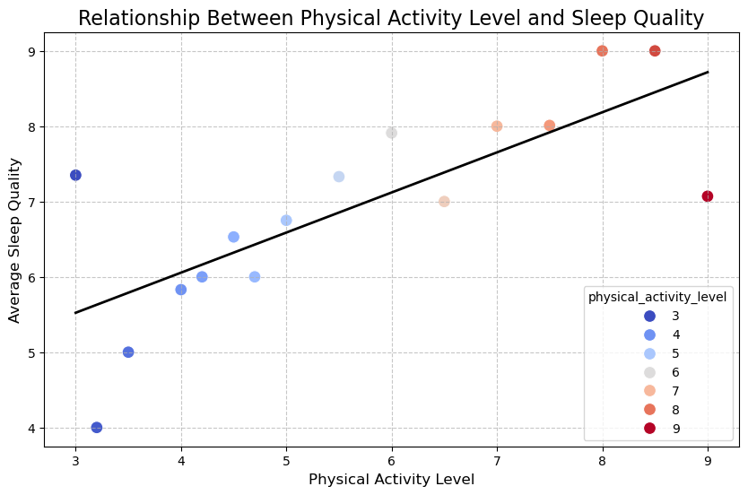
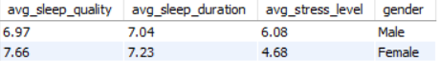
How age and gender affect sleep?
Sleep quality and BMI
6,4
6,8
7,6
sleep quality is in correlation with sleep duration
In this case, sleep quality increase as well as BMI
Normal
Overweight
Obese
Physical activity and
sleep quality
sleep quality is in correlation with physical activity level
The lowest values are in the range age [25,35] and [45,50]
In general, women have better “quality of life”

Slide 7
02
Mental Health Symptoms
Predicting Future Health Risks Based on Demographic Factors

Slide 8
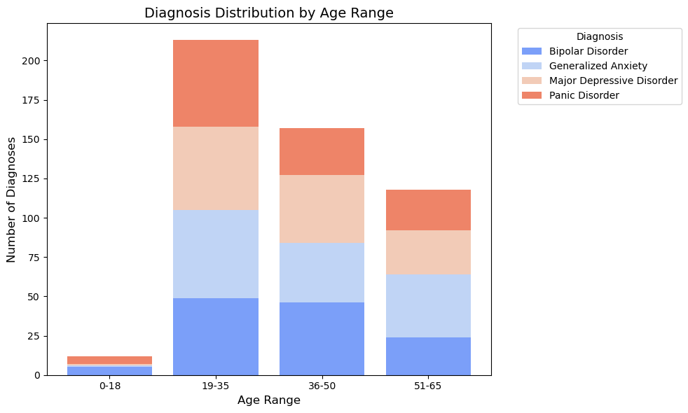
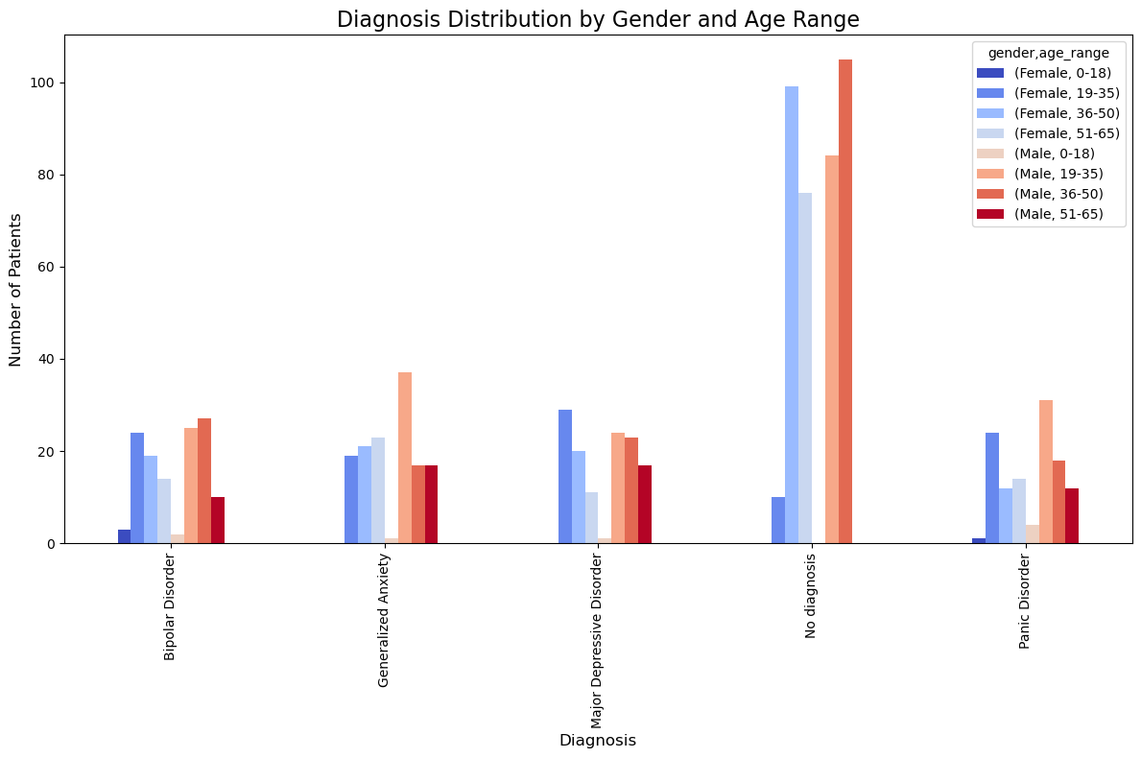
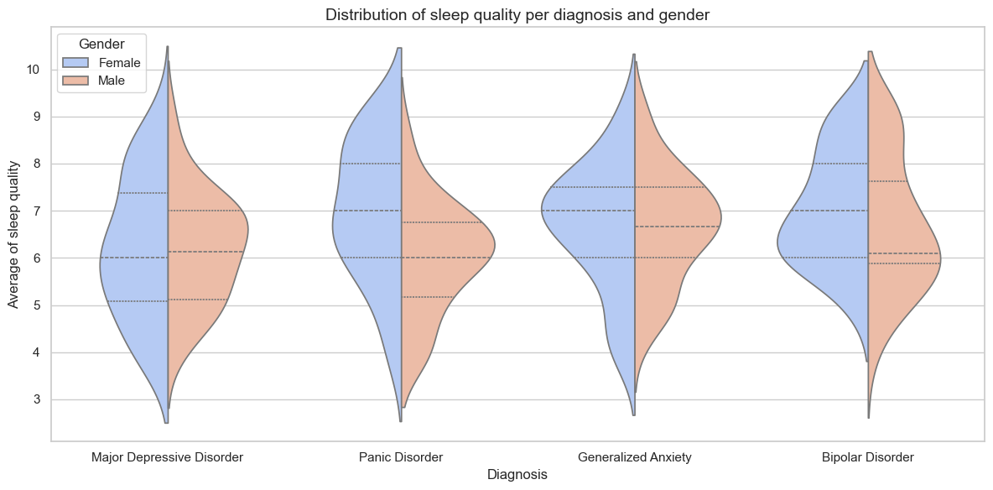
Among young workers
is more common have a mental health disease
Gender is not a risk factor in each diagnosis
Male tend to have a poorer sleep quality

Slide 9
03
Mental Health
Therapy
Analyzing treatment approaches, their success rates, and medication types

Slide 10
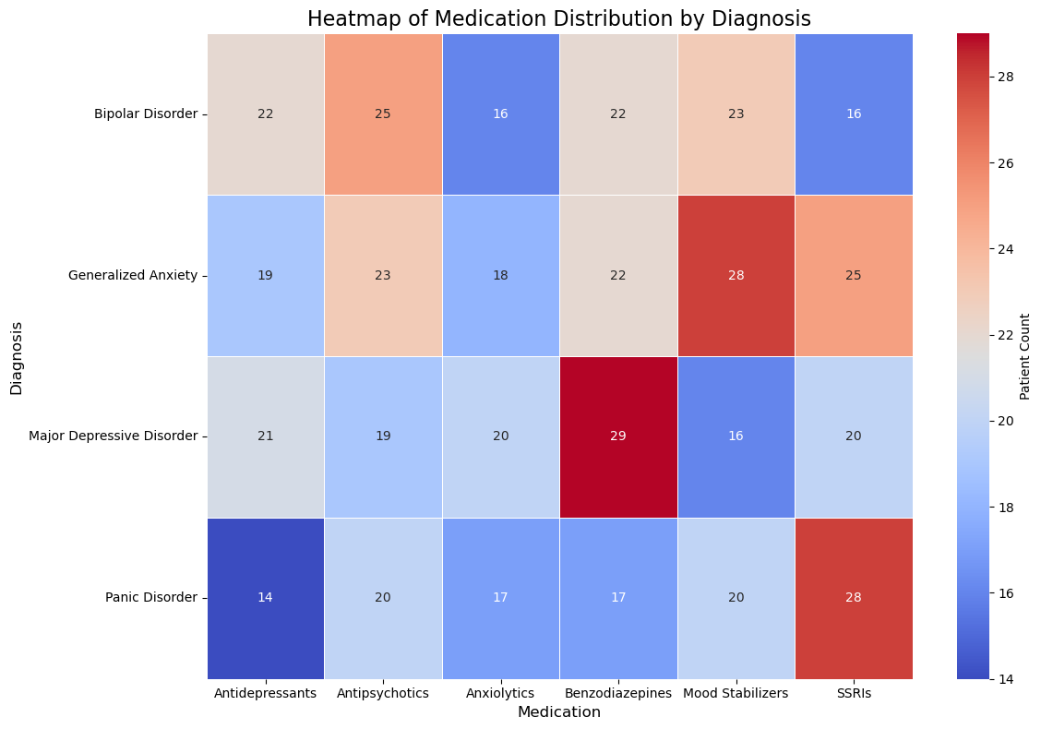
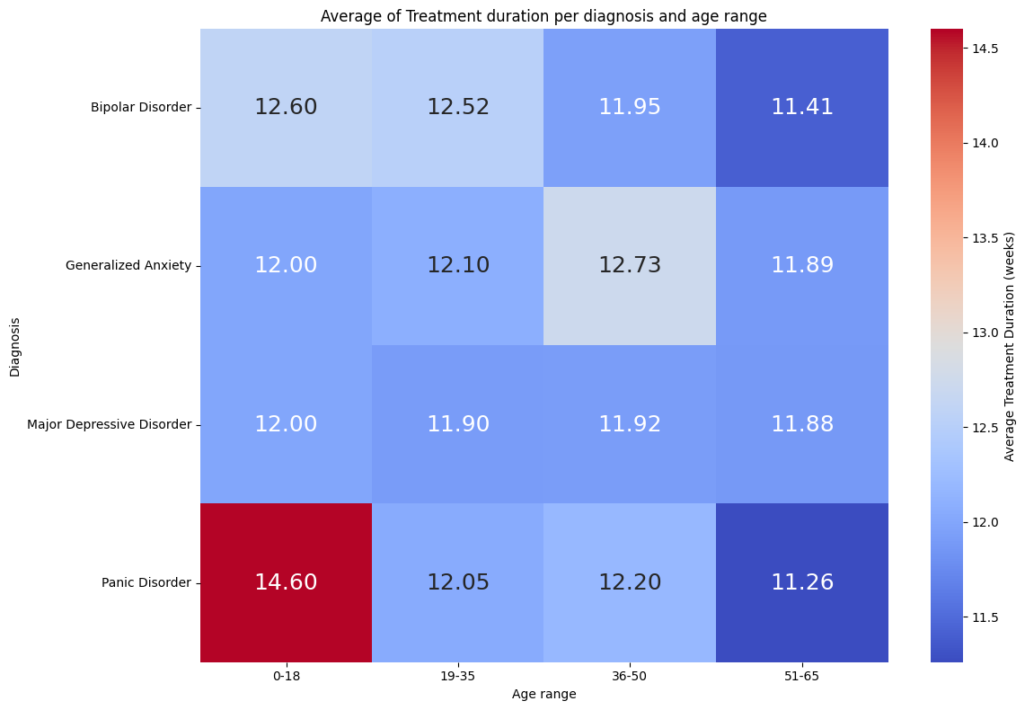
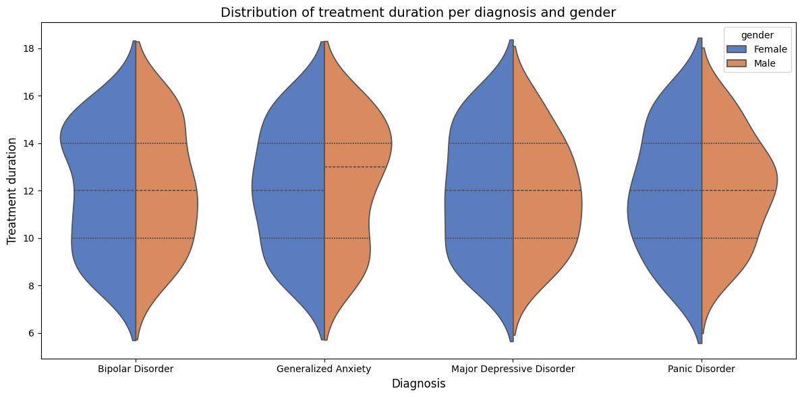
Diagnosis | Therapy | % Success Rate
Bipolar Disorder | Dialectical Behavioral Therapy | 40.0%
Generalized Anxiety | Mindfulness-Based Therapy | 43.2%
Major Depressive Disorder | Cognitive Behavioral Therapy | 37.1%
Panic Disorder | Dialectical Behavioral Therapy | 43.8%
Around 37%-44% is the success rate of the most used therapy methods for each different diagnosis
Each mental health diagnosis requires tailored medication for each case, but the average treatment duration ranges between 3 to 4 months across all diagnoses.
In general, gender does not affect to treatment duration

Slide 11
Conclusions
Stress & Sleep
Age & Gender
Therapy effectiveness
High levels of stress negatively impact sleep quality, especially in demanding jobs. However, factors like physical activity also play a significant role in sleep quality and also contributes to overall well-being.
Young people (aged 20-35) are more susceptible to mental health issues. While women report better quality of life, men tend to have poorer sleep quality.
Therapies show moderate success rates (37%-44%), highlighting the need for more personalized treatments.

Slide 12
Project methodology
Gather datasets from Kaggle and clean them to match project goals.
Create visual insights with Seaborn to highlight findings.
Data Retrieval
and Cleaning
Data Visualization
Data Querying
Conclusions
Use SQL to process and combine data, identifying key patterns and trends.
Extract actionable insights and summarize results.

Slide 13
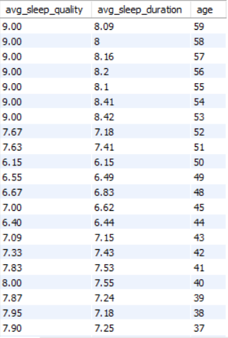
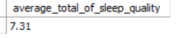
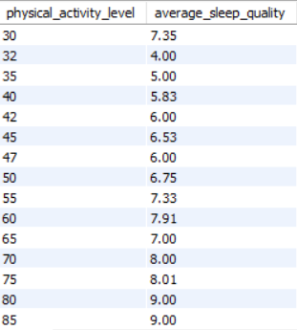
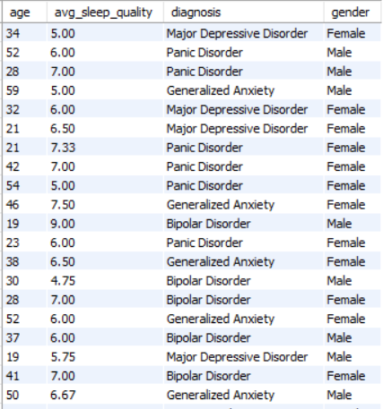
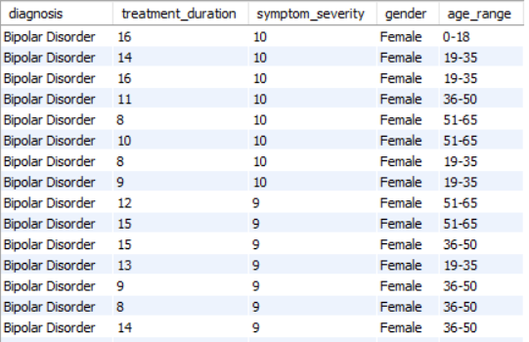
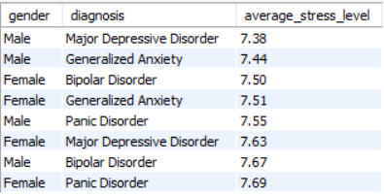
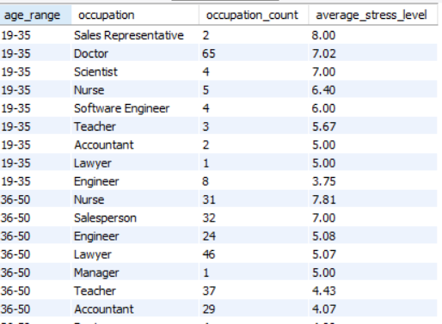
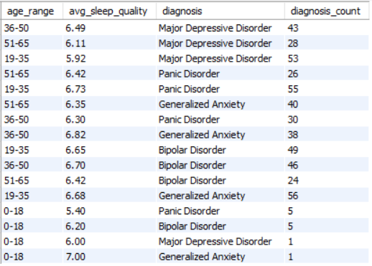
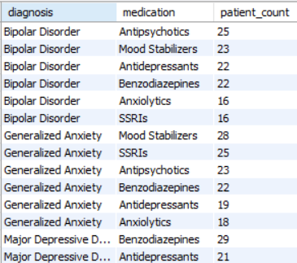
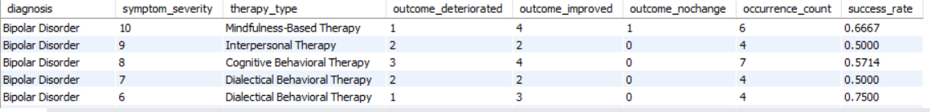
SQL

Slide 14
Thanks!
We hope you liked it!
Carlota Gordillo | Celia Manzano | Ana Pineda | Laura Sánchez

